Slide 1

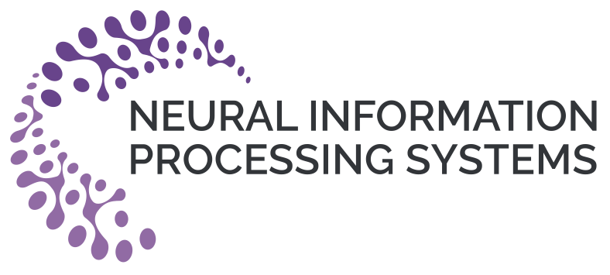
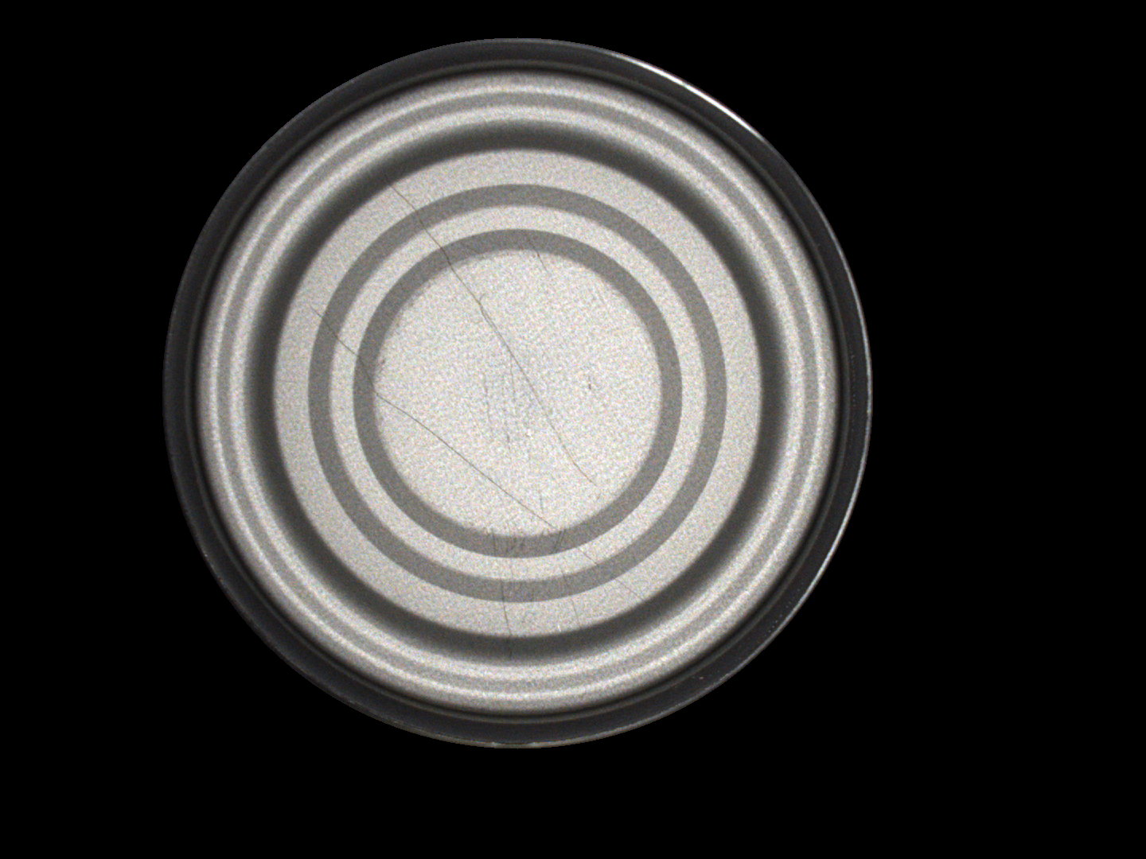
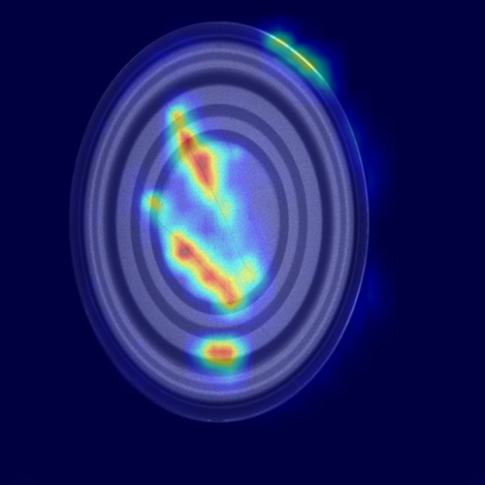
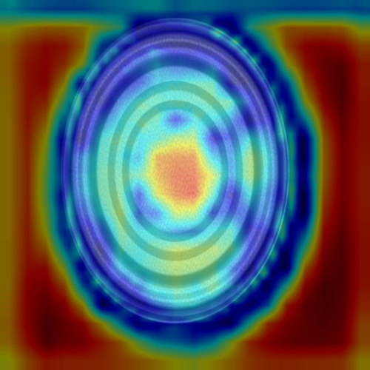
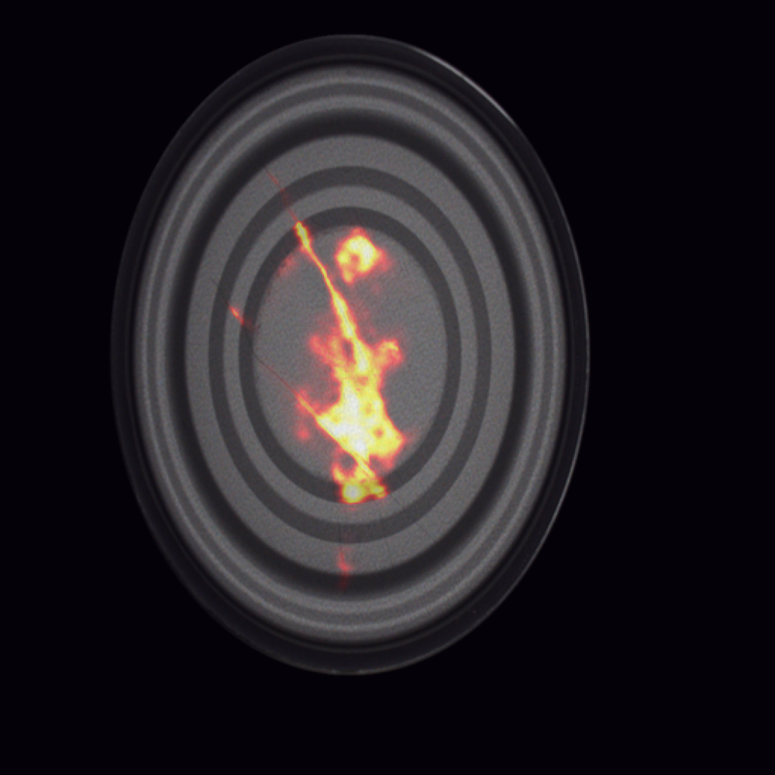
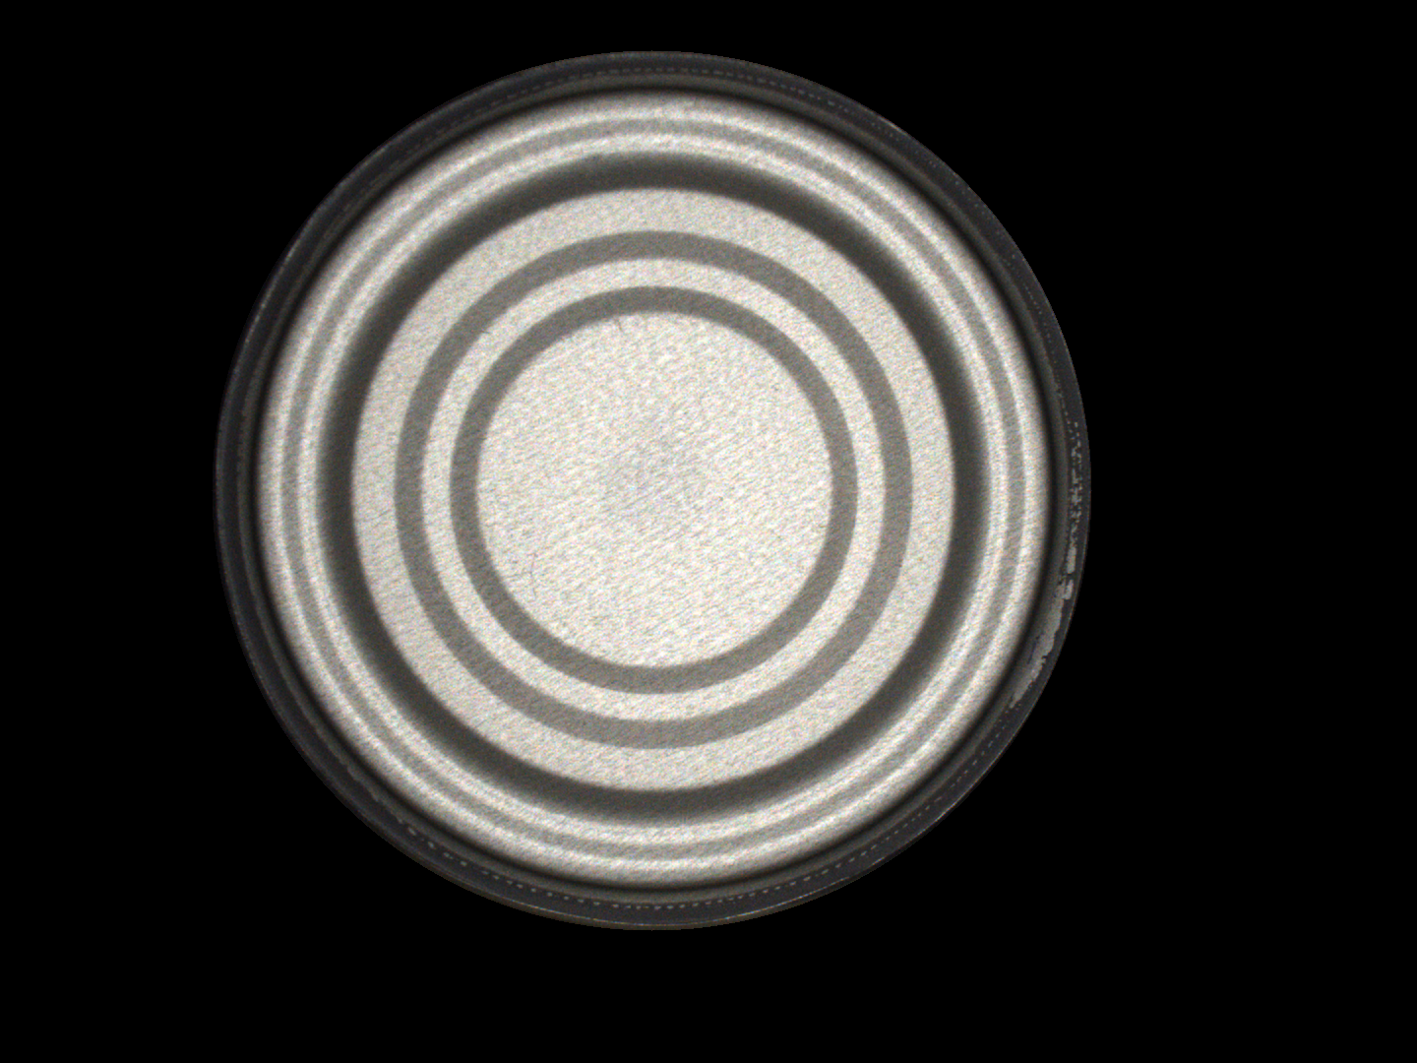
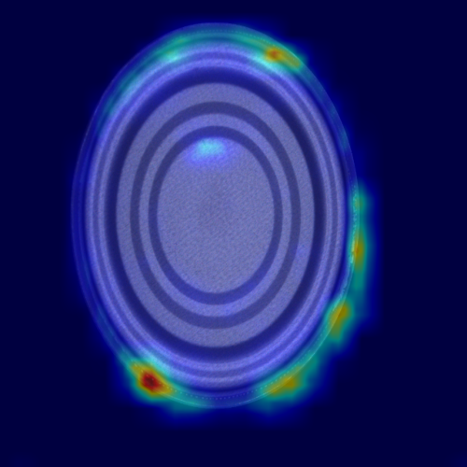
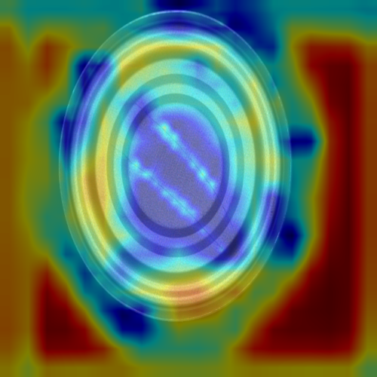
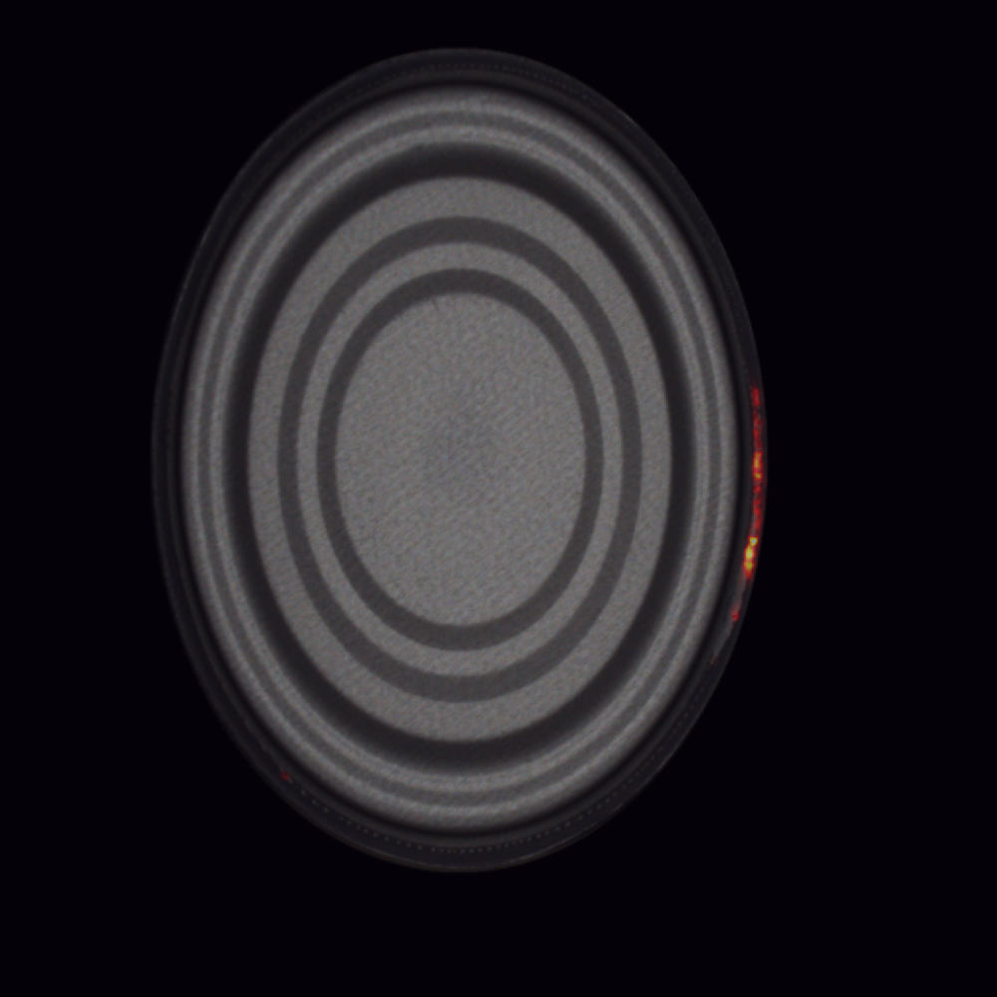
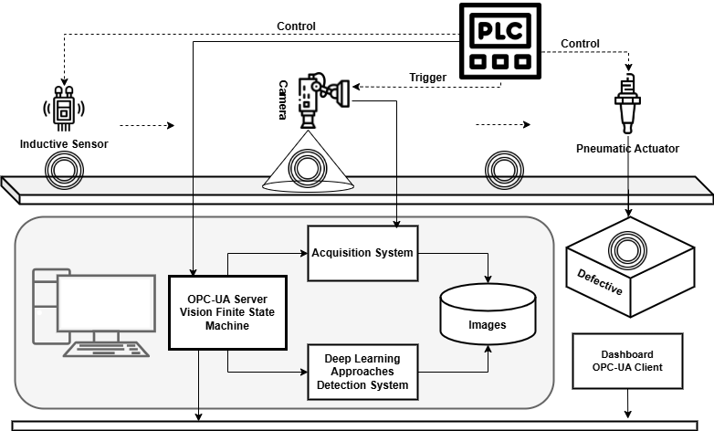
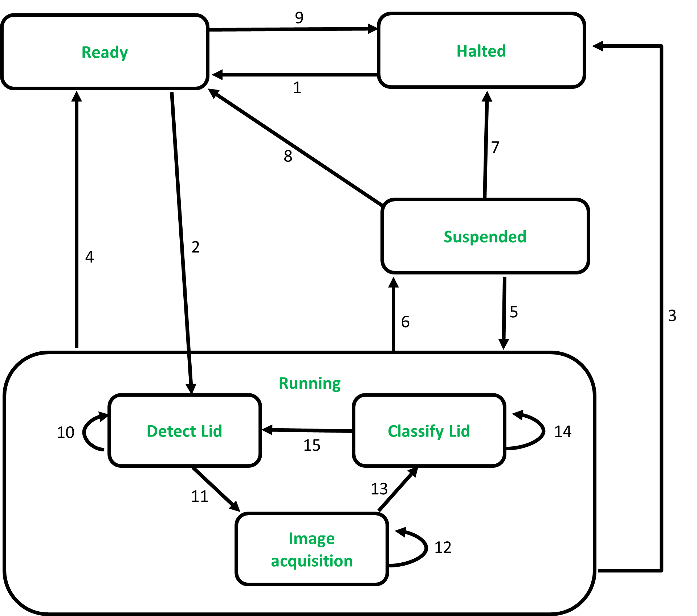
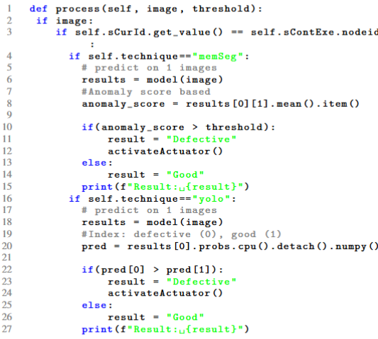



Anomaly Detection in Industry 4.0: Supervised vs. Semi-supervised Approaches with OPC-UA integration
Henry O. Velesaca, William Velesaca
Case Study
This work presents a novel approach to detect defects in industrial products by integrating OPC-UA with YOLO v8 and MemSeg. OPC-UA ensures secure and efficient communication between devices. The combination of these technologies makes it possible to monitor production lines in near real time and quickly correct defects, improving product quality and operational efficiency. A case study with detection of defects in tin lids demonstrates the effectiveness of the proposed approach.
Case Study
The system uses a Siemens S7 1200 PLC for control, an industrial RGB camera, a lighting system and an inductive sensor detects lids on a conveyor belt. A workstation with an Intel Core i9 3.3GHz CPU and NVIDIA Titan XP GPU is used in the supervision layer. This workstation is used for training and testing YOLOv8, acquiring images, and running the OPC-UA Server and YOLO v8 model inference.
For the OPC-UA Server implementation a finite state machine has been defined using the Part 16 of OPC-UA. The behavior model result is shown in Fig. 1.
The integration of YOLOv8 and MemSeg with the OPC-UA server is shown in Fig. 2 where the trained models are run inside the finite state machine.
The performance of the OPC-UA server with YOLOv8 and MemSeg is evaluated using Execution time (CPU, GPU) and Average Accuracy. The evaluation is based on test images. The Table 1 show the performance evaluation using Execution Time and Average Accuracy per each approach.
The YOLOv8m model is used for training and accuracy of 99.6% is obtained. The Figure 3 show prediction results examples in testing set.
Abstract
Image
YOLOv8m
YOLOv8s
MemSeg
Interior peeling
Missing rubber
Proposed Approach
The proposed approach is based on a hierarchical system architecture with three layers: Control (PLC), Supervision (OPC-UA, Deep Learning), and Visualization (dashboard) (see Fig. 1). In the case study, an anomaly tinplate detection system is implemented. The objective is to include the YOLOv8 and MemSeg trained model within the OPC-UA Server with a Finite State Machine. The integration improves real-time anomaly detection and defects classification. Execution time (CPU, GPU) and Average Accuracy metrics will be calculated to establish the performance of the system.
Figure 3: YOLO v8 prediction results. These example images are part of the testing set.
Proposed Approach
Conclusions
The proposed methodology integrates OPC-UA with YOLOv8 and MemSeg to improve anomaly detection in industrial processes, specifically for tinplate production, addressing the limitations of traditional human inspection methods. YOLOv8 (fully supervised) shows better performance than MemSeg (semi-supervised). The detailed architecture and interaction between system components demonstrate efficient near-real-time defect detection. The experimental results show that this integration provides significant benefits, such as secure, standardized communication, and improved operational efficiency and product quality.
Conclusions
Figure 1: General outline of the proposed system architecture in this paper.
Figure 1: Finite State Machine for defect detection system in tinplate lids.
Figure 2: Code executed in FSM in OPC-UA server with YOLO v8 and MemSeg.
Technique | Execution Time |  | Average Accuracy (%)
 | CPU(ms) | GPU (ms)
MemSeg | 71.25 | 39.90 | 0.976
YOLOv8m | 218.90 | 67.50 | 0.996
YOLOv8s | 99.65 | 25.55 | 0.991
Acknowledgements
This research has been partially supported by
The ESPOL project CIDIS-004-2023.
Acknowledgements
Table 1: Performance evaluation Execution Time and Average Accuracy per each approach.
hvelesac@espol.edu.ec, wvelesac@espol.edu.ec
Paper

